Slide 1

Chinon Development (Group 2)
Tony Dugas, Jason Klas, Daniel Sandoval, JP Stearns, Lawrence Tilton

Slide 2
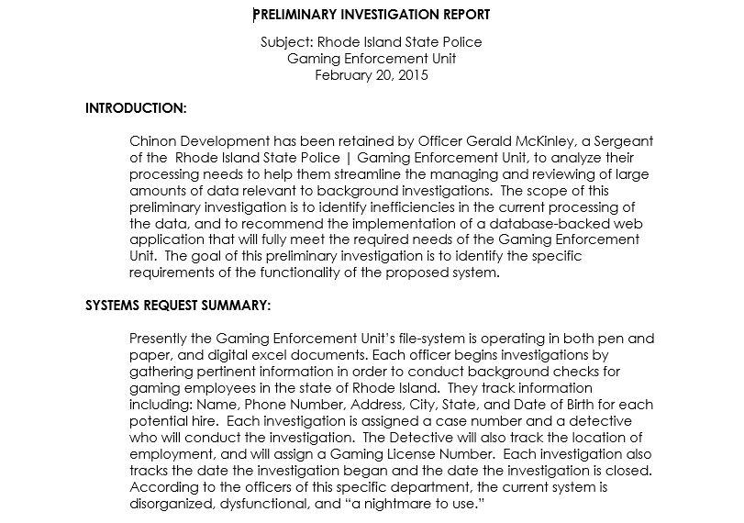

Slide 3
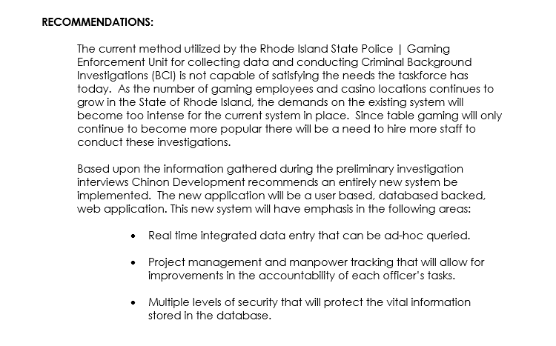

Slide 4
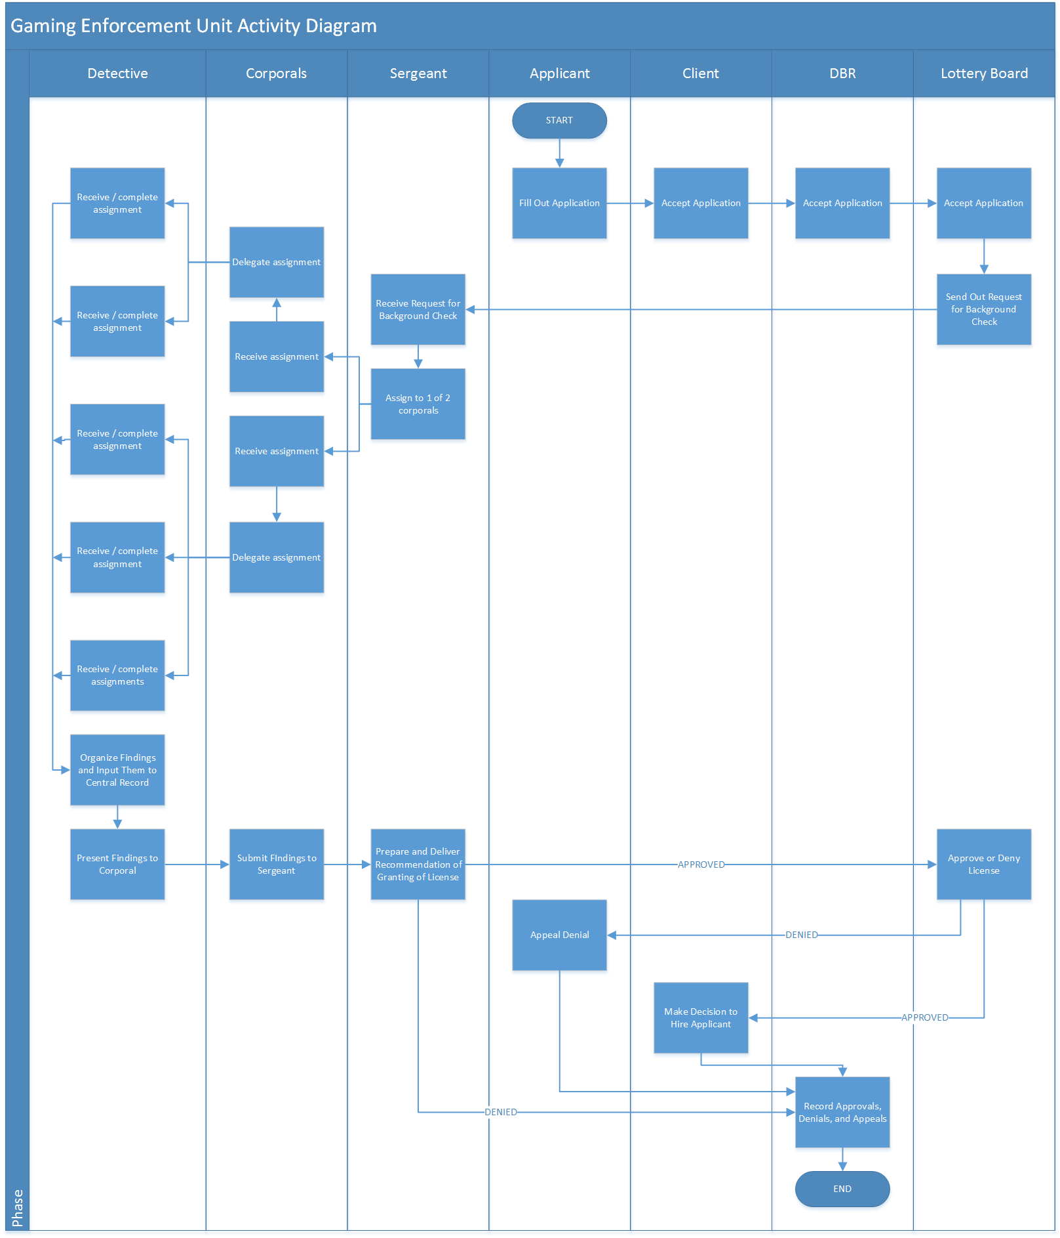

Slide 6
Interface Data Processing By Detectives
Data Entry
Rhode Island State Police Gaming Enforcement Unit Database
Assignment Retrieval
Corporal
Casino
License Request
Labor Management
Super User Interface for Sergeant
MIS: Management and Support
Assignment Entry
Operations Standards
Final Report Retrieval

Slide 7
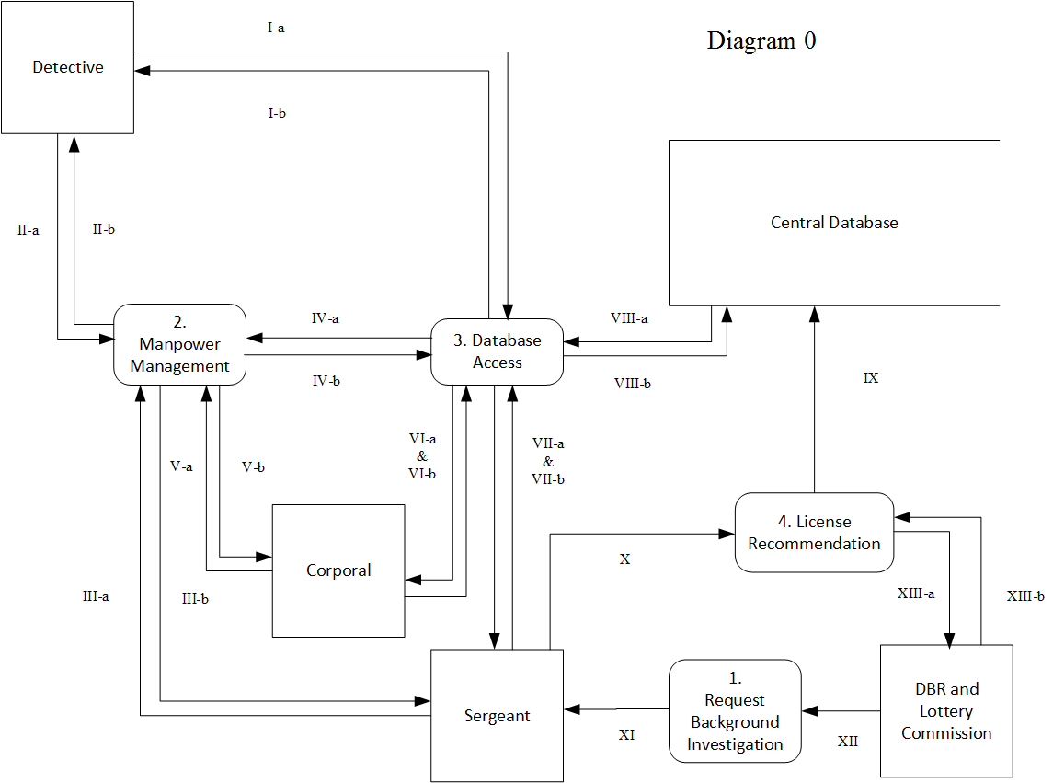

Slide 8
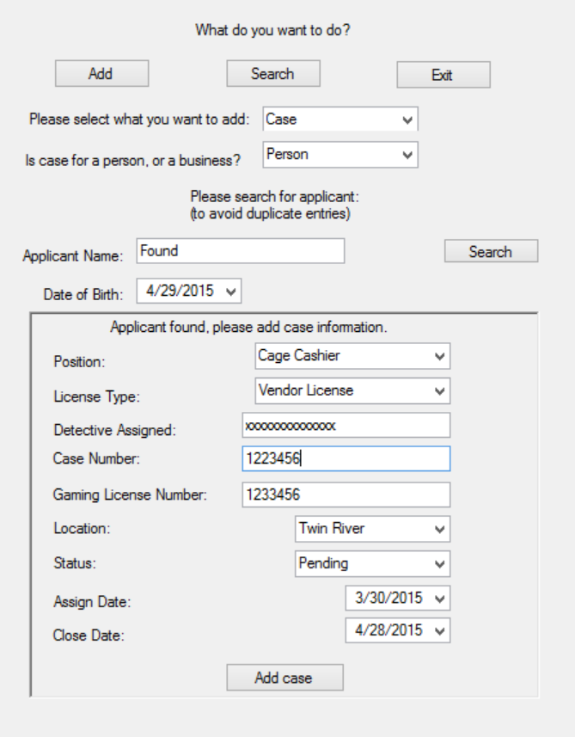


Slide 9


